Slide 1
Virtual Horse Show
Big Thank You to Kim Fiore of the Virtual Draft Horse Show on Facebook
For letting me beg, borrow and steal!

Slide 2
Virtual Horse Show –
Or any activity you can video and judge
Pet Show – best dressed, best trick
Livestock – cattle, sheep, etc.
Antique Cars – show engine, interior, body
Talent Show
Decorated Bike

Slide 3
Virtual Horse Show – Planning List
Find a judge(s) who is willing to work from video
Create a schedule of dates for the various deadlines
Determine how payments will be submitted
Determine entry forms hosting platform
Determine how participants will submit video
Create a class list and class descriptions
Create a rules, guidelines and tips document

Slide 4
Virtual Horse Show - Judging
Criteria for selecting your judge(s)
Willing to watch videos to perform their judging function
Willing to help create the class descriptions. Especially for the classes where the judge or helper is normally issuing commands to the class.
Has good access to internet
Has reasonable computer skills
  Familiarity with Excel
  Familiarity with Facebook

Slide 5
Virtual Horse Show - Schedule
Create a list of the relevant dates
Date entry forms and class descriptions will be made available on the chosen platform
Date the entry forms and payments must be submitted by
Date videos must be uploaded and the link submitted by
Date results will be published

Slide 6
Virtual Horse Show - Payments
Determine which methods will be supported for payments
Cash, requires a meetup
Cheque, can be mailed, better in social distancing situation
Etransfer, easiest, safest and fast, but has fees for the user. Need to ensure your bank account can accept etransfers.

Slide 7
Virtual Horse Show – Hosting w/Facebook
Determine which platform you will utilize to host the show
  Create a facebook group to host the show. Entrants will join this group. Documents are loaded into the file section for the group including class list, rules, etc.
  Entrants will link their video to a specific post within the group for each class they are participating in.
  Judge goes to Facebook to get the link to view the videos, provide their comments and reward the class placings
  Pros - free, most people are familiar with Facebook, easy for participants to view their fellow competitor’s performances. Family members can also be part of the Facebook group and cheer.
  Cons – not everyone is on Facebook

Slide 8
Virtual Horse Show – Hosting w/Google
Determine which platform you will utilize to host the show
  Publish all of the information on the show on your fair’s website including, dates, class lists, how to submit, etc.
  Create a gmail account just for the fair to use for virtual show purposes
  Entrants upload their video and then email the gmail account with the links for the classes they are participating in
  Emails are then forwarded to the judge or an excel spreadsheet is created with the information organized into classes.
  Pros, free, most people have access to email, excel with links can be sent to all participants for them to see all of their fellow competitors performances
  Cons, no audience

Slide 9
Virtual Horse Show – Hosting Video
Determine which platform the entrants will submit their videos to
You Tube
  Entrant creates their own channel and then uploads videos from any smart device. Link can then be copied and posted to the chosen entry site. You do not have to authorize users to share their videos
Media Sharing Site
  There are all kinds of sites where you can upload data to and share with other users. They typically need the site owner to authorize each person who can upload and or view the files on the site. Permission to view will have to be granted to the judge.

Slide 10
Virtual Horse Show – Classes
Create a list of classes that are home video friendly
Obstacle/trail classes need to have fairly simple everyday obstacles, ie tarps, poles, person waving a flag, etc.
Classes that are normally run according to judge’s commands, will need to be written up with instructions with a routine. For instance circle the ring once at the walk, pick up trot, trot half way around the ring and pick up canter, etc.
Jump courses need to have heights specified. And layout provided.

Slide 11
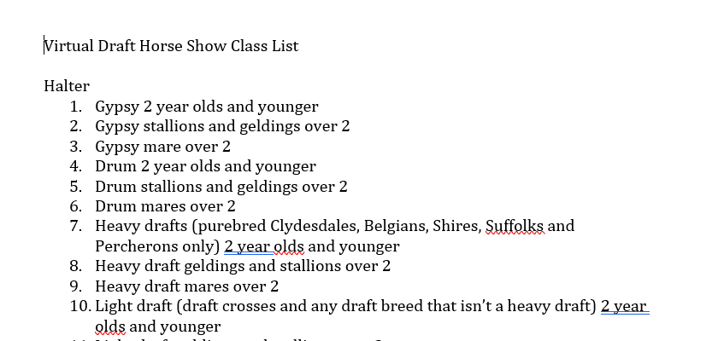
Virtual Horse Show – Sample documents from the Virtual Draft Horse Show
.

Slide 12
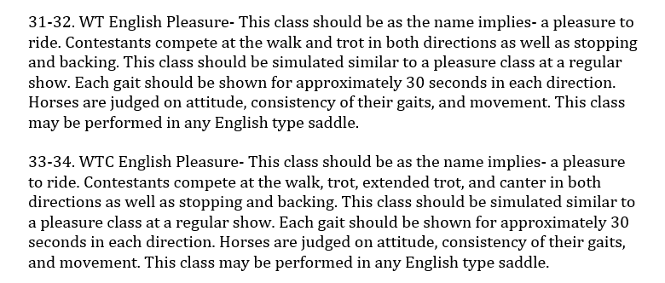
Virtual Horse Show – Sample documents from the Virtual Draft Horse show
.

Slide 13
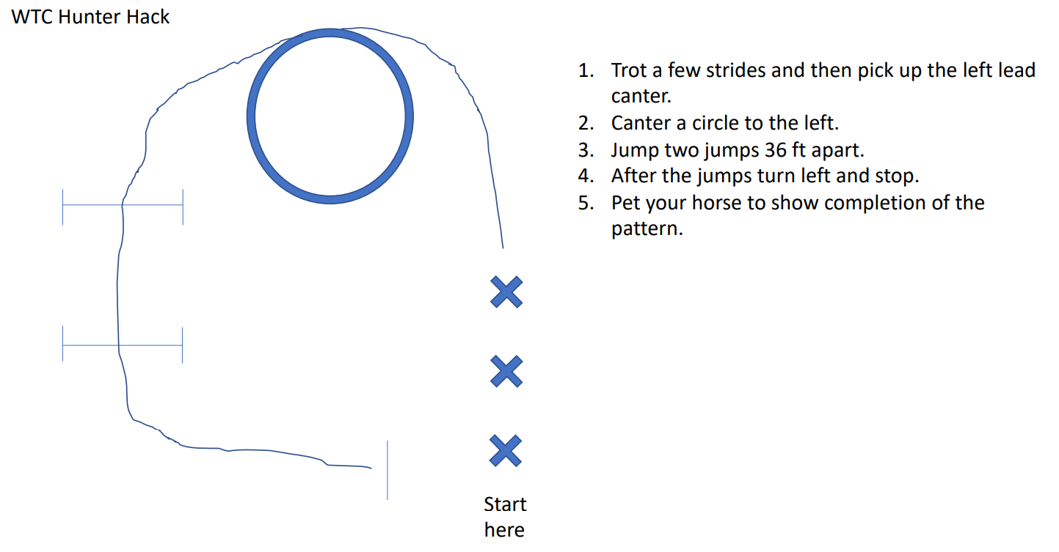
Virtual Horse Show – Sample documents from the Virtual Draft Horse show
.

Slide 14
Virtual Horse Show – Rules
Create a rules, guidelines and tips document
Do competitions need to wear show gear? Or is schooling equipment acceptable.
Are horses allowed to wear schooling equipment, ie boots, wraps
Videos must be filmed in landscape and not edited
Can two different riders use the same horse/pony in the same class?
Can a rider, use two different mounts in the same class

Slide 15
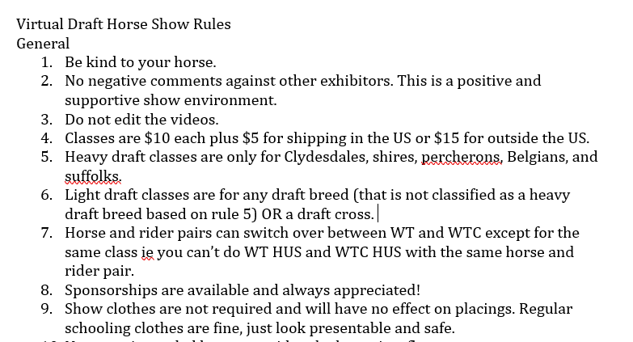
Virtual Horse Show – Sample documents from the Virtual Draft Horse show
.

